Slide 1
CPSC463-01 PROJECT 1
Thomas Ngo

Slide 2
Motivation of unit test
Reduce bugs in New Features
Reduce bugs in Existing Features
Good documentation
Reduce the cost of change
Improve current design
Allow refactoring

Slide 3
Motivation of unit test (cont.)
Constrain Features
Defend against other programmers
Force programmers to slow down and think carefully
Makes development faster
Reduce fear of change

Slide 4
Creating a Unit test
Step 1: Import the unittest module in your program
Step 2: Define a function to be tested. In the following example, add() function is to be subjected to test
Step 3: Create a test case by subclassing unittest.TestCase
Step 4: Define a test as a method inside the class. Name of method must start with ‘test’

Slide 5
Creating a unit test (cont.)
Step 5: Each test calls assert function of TestCase class. There are many types of asserts. Following example calls assertEquals() fucntion
Step 6: assertEquals() function compares result of add() functioni with arg2 argument and throws assertionError if comparison fails

Slide 6
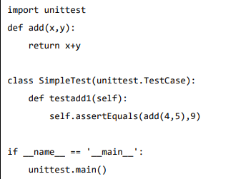
Creating a unit test (cont.)
Finally, call main() method from the unittest module

Slide 7
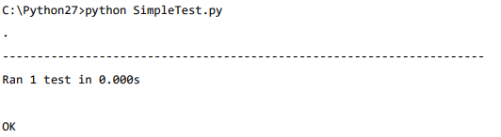
Create a unit test (cont.)
Step 8: Run above script from the command line

Slide 8
Framework unittest Pros and Cons
Pros:
  Python standard library
  Easy to write test case
Cons:
  Require users to be tedious in collecting test case and test suites
  Not easy to extend as other framework

